Slide 2
Wrangling git’s not at all existent UX to make it do useful things

Slide 3
A study of git’s commands and why they’re so difficult to use

Slide 4
Usability, what’s that?
- git

Slide 5
Using git bisect to track down hard to find issues

Slide 6

I do computer things Sometimes they work
Fosstodon: @corbob
GitHub: corbob
LinkedIn: KnoxCory
Website: coryknox.dev
Discord: Corbob#9562

Slide 7
Outline
What is git?
What is git bisect?
What makes it efficient?
When should I not use git bisect?
When should I use git bisect?
How to use it
Demo

Slide 8
What is Git?
Distributed Source Control
Not GitHub
Not GitLab
Directed Acyclical Graph

Slide 9
What is a git bisect?
Method for searching between two commits
Used to find where a behaviour change was introduced
Binary Search

Slide 10
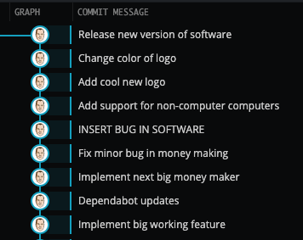
Ideal git history

Slide 11
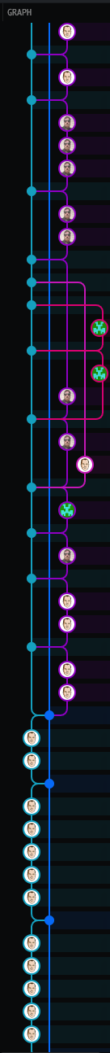
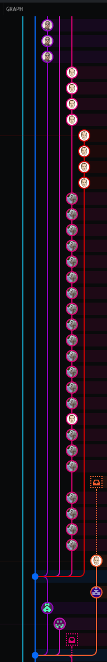
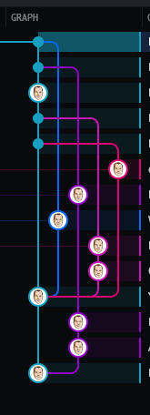


Slide 12
What makes it efficient?
Uses a Binary Search
Split the search space in half
Determine if the behaviour exists or not
Eliminate half of the search space
Repeat
You don’t have to worry about the branching and ordering of the commits

Slide 13
When not to use it?
When you cannot reliably reproduce the issue
When you know exactly what line of code is causing the issue
When you know exactly when the behaviour was introduced
When you have a few commits and are reasonably sure where the behaviour was introduced

Slide 14
When should you use it?
When you can reliably reproduce the issue
When you don’t have an error message that tells you exactly where the issue is
When you don’t know exactly when the behaviour was introduced
When you have a lot of changes to look through

Slide 15
How to use git bisect - manually
git bisect start
git bisect good commit-ish
git bisect bad commit-ish
# Perform action to determine if behaviour exists
git bisect good if behaviour does not exist
git bisect bad if it does
# repeat
git bisect reset

Slide 16
How to use git bisect - Automatically
git bisect start
git bisect good commit-ish
git bisect bad commit-ish
git bisect run <command to determine if behaviour exists>
# You’re now at the commit that introduced behaviour
git bisect reset

Slide 17
When to use git bisect - Automatically
Must be able to detect the behaviour change with a script/executable
Your script/executable must exit 1 if behaviour exists, and 0 otherwise
Use when the reproduction steps are cumbersome
Use when there are lots of potential commits

Slide 18
It’s DEMO Time!

Slide 19
Questions?

Slide 20

Session reviews
Don’t forget to review the session

